Slide 1
HPS Experiment Overview
John Jaros HPS Collaboration Meeting at JLAB November 16, 2016

Slide 2
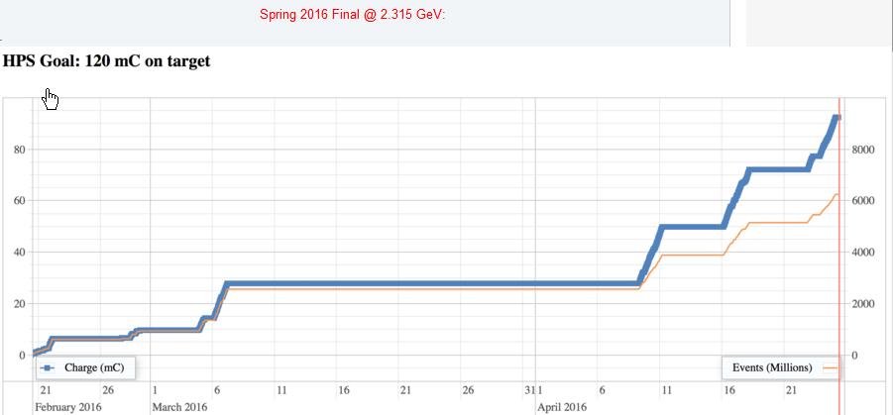
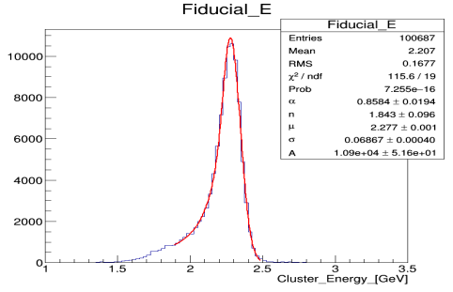
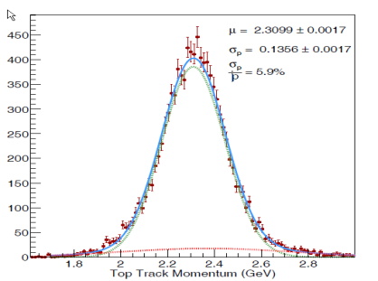
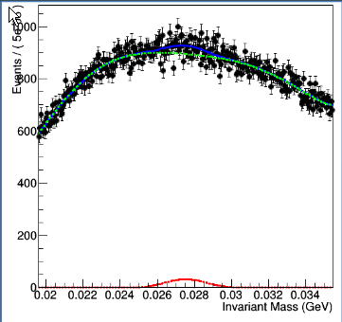
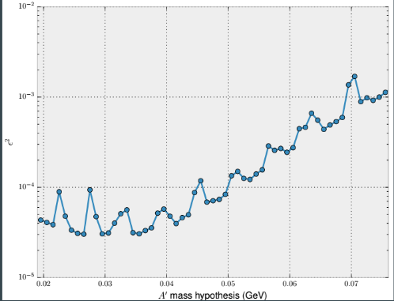
Remember April Collaboration Meeting at SLAC
2016 Engineering Run was going well.
2016 detector performance looked good
Omar showed his results from the first bump hunt analysis of the unblinded 2015 data
5 PAC days at 2.3 GeV!
ECal
SVT
e+e- mass
limits

Slide 3
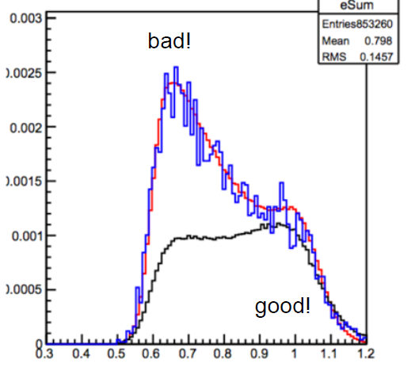
At the SLAC Collaboration Meeting
Hopes for conference results by summer’s end and submission of a publication soon afterwards
But at least one nagging question surfaced:
Why do data and MC disagree for trident Esum?

Slide 4
This Talk: HPS from then ‘till now
HPS approvals, workshops, requests, and data processing
The Trouble with ESum
First Physics Analyses
Vertexing Shortcomings and Fixes
The Upgrade
Preparing for the 2018 Run
Publish or Perish
Conclusions

Slide 5
Soon after the meeting: HPS Approval
HPS Physics Readiness Document was submitted to JLAB management March 6, 2016.
On the basis of demonstrated performance, it argued that HPS was ready for unconditional approval of its 165 remaining PAC days.
Bob McKeown email of 4/29/2016: “We have reviewed the updated HPS Physics Readiness Document, and conclude that indeed HPS has fulfilled the condition imposed by the PAC regarding a successful test run. We therefore agree that HPS should receive full approval, with a total of 180 PAC days of beam time.”

Slide 6
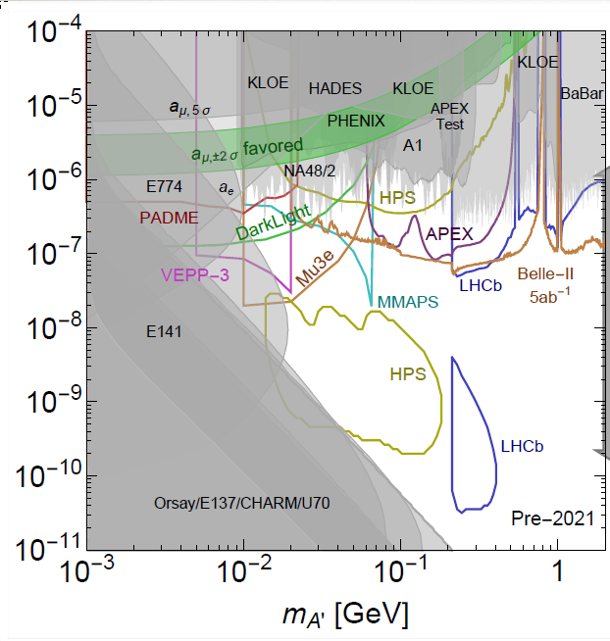
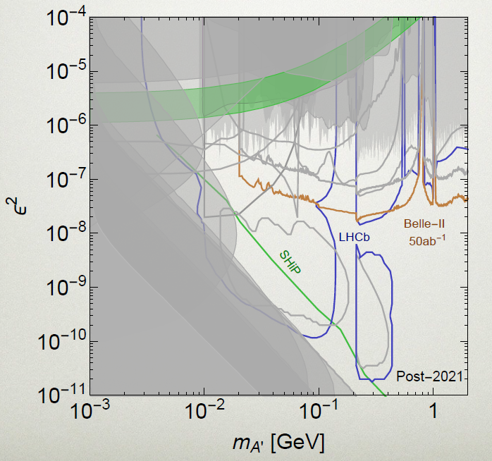
Dark Sector Workshop 2016
Directly followed the SLAC Collaboration Meeting
Attended by the “Hidden Sector Physics” community
Documented that HPS will have competition before 2020, like Mu3e, APEX, Belle II, Darklight, … but not in the vertex region.
After 2020, look out for LHCb and SHIP, everywhere.
Before 2020 After 2020

Slide 7
HPS Beam Time Request
JLAB issued a formal call for Beam Time Requests to cover CY 2018 on July 1, 2016.
HPS Request was developed in EC: * 57 PAC days total * 25 PAC days at 2.2 GeV (4 days for beam setup, commissioning, and diagnostics) * 32 PAC days at 4.4 GEV (4 days ditto)
Still based on reach estimates from the 2013 proposal
HPS is waiting for release of the 2018 schedule
Diagnostics 1. Change tgt t 2. No tgt 3. straight thrus 4. change I 5. pulser only 6. trigger checks

Slide 8
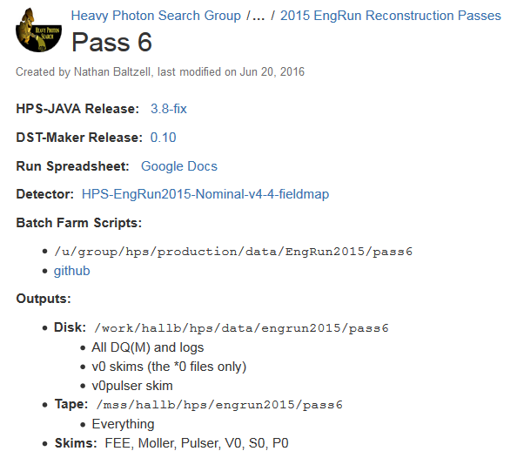
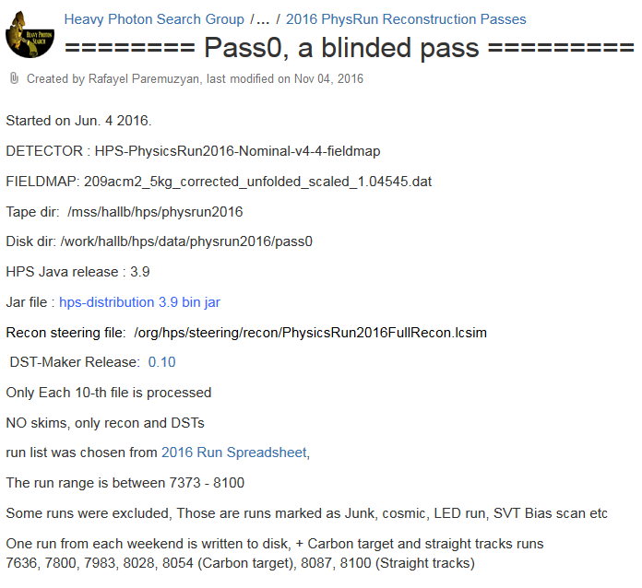
Progress with Data Processing
Final 100% Pass of 2015 data First 10% Pass of 2016 Data
Thanks Rafo and Nathan

Slide 9
Trident Summit
Matt and Nathan proposed the Trident Summit aimed at understanding and resolving the trident Esum problem:
Many contributed to the meeting agenda: https://confluence.slac.stanford.edu/display/hpsg/Trident+Summit%3A++July+25-26%2C+2016
Lots of Important Results and New Approaches were discussed
Trident Summit Followup Summary (thanks Nathan) provides a convenient place to reference developing results. https://confluence.slac.stanford.edu/display/hpsg/Trident+Summit+Followup+Summary

Slide 10
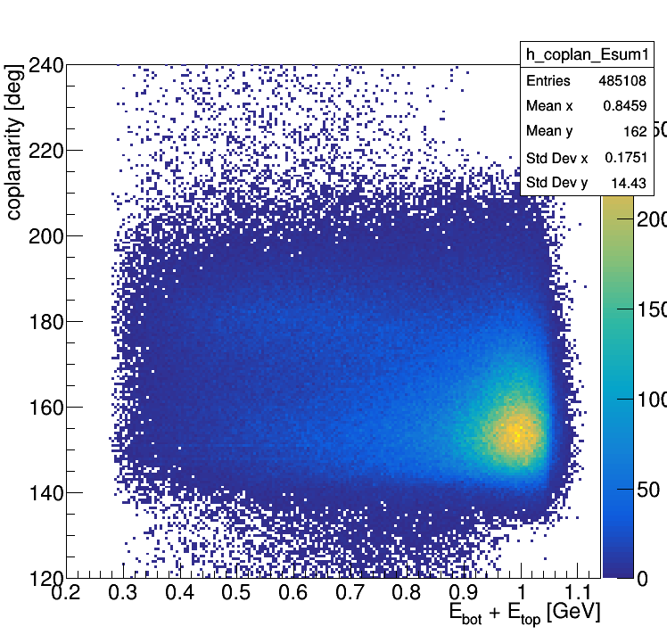
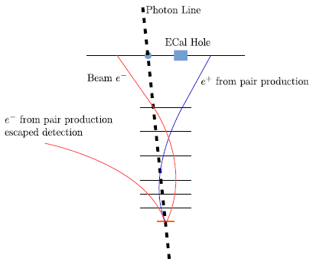
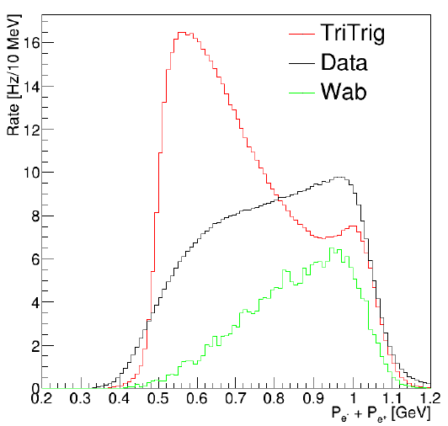
What can be wrong with Esum?
Some physics left out ?
Trident generation faulty ?
Trigger/Ecal inefficiency ?
Track reconstruction inefficiency ?
Normalization errors ?
Some Physics was Left Out (thanks Rafo)
Large WAB cross section WABs Convert! WABs contaminate Tridents

Slide 11
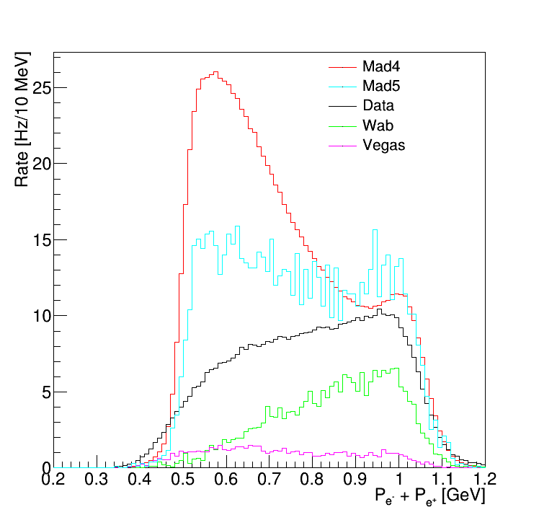
What’s wrong? Trident Generation?
Takashi checked HPS Madgraph 4 = APEX Madgraph 4 = APEX rate measurement. Checks!
Luca and Rouven and student are debugging M4, M5, and Vegas (Luca’s standalone using Beranek’s code)
Status in October (Rafo):
Status now?
M4 ≠ M5? Trident + WAB ≠ Data?

Slide 12
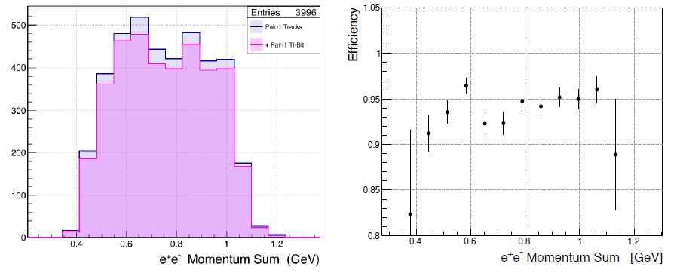
What’s Wrong? Trigger/Ecal Efficiency?
The worry: Tridents heavily populate Ecal edge crystals, where gain drops and resolution is poorly determined. Is the trigger fully efficient at low ESUM?
The answer: Yes, trigger/Ecal is OK (thanks Nathan) Use SVT tracks in pulser triggers to select events which should have triggered. Check if Pair 1 TI bit is set.

Slide 13
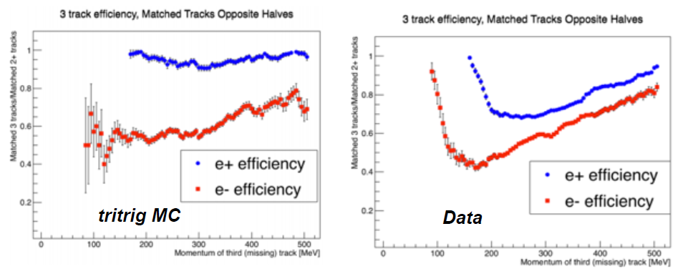
What’s Wrong: Tracking Efficiency?
Worry: If the data and MC have different tracking efficiencies, especially at low ESUM, this could account for ESUM shape discrepancies.
Track efficiency at low momentum is worse in data than MC, using both 3 prong and 2 prong events. (Thanks Rafo, Holly, and Matt)
Do the different studies agree? Is there a quantifiable impact on ESUM? Does it account for the data/MC discrepancy?
Holly’s Results

Slide 14
What’s wrong: Normalization Errors?
Data rates look lower than MC trident and WAB rates. * Holly sees Ecal only data rates ~ ½ wab beam tri rates * Rafo sees Ecal only data rates ~ ½ wab beam tri rates * Sho fits high Esum data to (trident+wab) x 0.65 * Matt fits Esum data to = (wab beam tri) x 0.65
Consensus: The data rate is ~65% of the MC pairs rate for Ecal only, and for fully tracked tridents.
Why?

Slide 15
Climbing toward the summit for a long time. Are we there yet?
HPS has made critical headway in understanding tridents.
What do we really need before proceeding to final results * Understand the composition of the x>0.8 tridents → radiative fraction * Trust the measured trident yield for x>0.8 * Eliminate converted WABs and know efficiency for doing so
What would we like? * Understand why data/MC = 0.65 * Understand all Esum * Understand rate dependencies
Do we understand enough to proceed?

Slide 16
First Physics Analyses Completed!
Omar’s thesis provides a basis for the HPS bump hunt analysis and a true measure of HPS reach.
Sho’s thesis provides a basis for the HPS vertexing analysis and the vertex reach.
HPS students (Holly, Ani, et al.) are playing a critical role in taking the next steps * Moving from the 10% sample to the 100% sample * Accounting for converted WABS * Including the 1.5 mm data
So are post-docs and staff (Matt, Nathan, Rafo, Norman, Takashi, Alessandra, Omar,…)

Slide 17
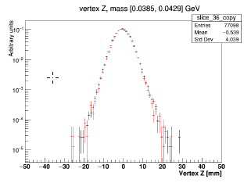
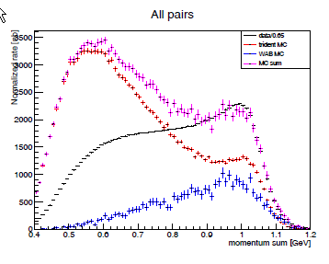
Sho’s Vertexing Analysis
Good News: * Vertex distributions are well described by MC * The composition of the x>0.8 sample can be described with reasonable assumptions. True? * Converted WABs have little impact on the analysis. Anti-WAB cuts eliminate most of them. * The apparatus for setting limits has been exercised and tested.
Not so Good News * HPS proposal did not account for acceptance vs decay length effects. * Significant backgrounds exist beyond zcut. * Limits obtained are much worse than projected in the Proposal

Slide 18
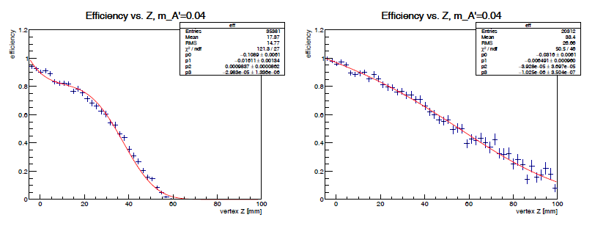
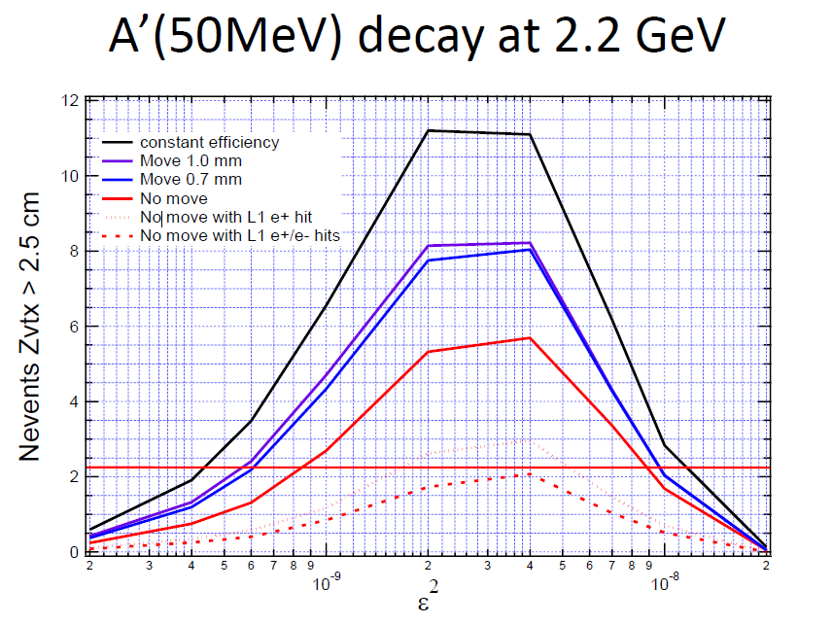
Vertex Efficiency vs Decay Length
Downstream decays see fall off in vertex efficiency vs decay length
Significance (∝ N_{events}> Z_{cut}) is much worse than 2013 proposal
Sho’s analysis uses L1-L1 only
Using L1-L2 and
L2-L2 helps a lot
ε
L1-L1
ε
L1-L1 L1-L2 L2-L2
Assumed in proposal
z → z →
Takashi
Proposal
Present HPS
Sho’s L1-L1

Slide 19
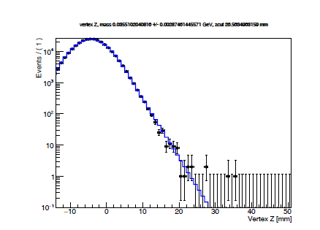
Vertex Backgrounds beyond Zcut
Sho finds a significant background beyond zcut
Needs study in the data; may need generation of a large MC sample to develop new cuts.
Vertex Distribution for 32.6 MeV < m_{e+e-}< 38.4 MeV
MC well-describes exponential tail
Zcut
4 events seen beyond Zcut but only 0.5 expected for all mass slices!

Slide 20
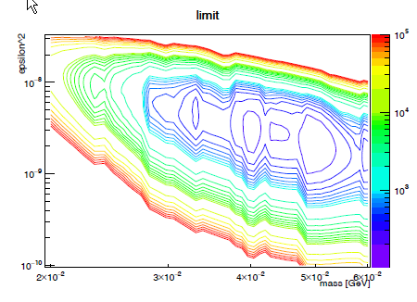
Sho Excludes 115 x canonical A’ Rate
Sho’s analysis is far from setting a meaningful limit using the 10% unblinded 2015 data.
Lowest point in the plot is 115. 90% CL limit requires a region have limit ≤ 1.

Slide 21
Can we Recover Vertex Reach?
Sho’s result is for an L1-L1 analysis with 10% of the 2015 0.5 mm data.
How to improve on this limit? Starting point 115. Assume no bkg 86. Use all 0.5mm data 14.7 Include L1-L2 and L2-L2 6.8 More ∫Ldt: 1.7 days→ 28 days 0.6 Move layers 2 & 3 closer to beam 0.4? Other improvements 0.2??
Present 1.7 PAC days of data doesn’t produce a viable limit, but 4 weeks of data will and scheduled improvements will.
We still have an experiment!
Sho’s calc

Slide 22
Sho’s Limit for 28 days excludes a finite region of parameter space
90% CL limit

Slide 23
Re-evaluating Reach
It’s important for HPS to quantify its reach, accounting for the realities that our first analyses have brought to light. This is necessary HPS homework. Got to know what we can really do.
HPS needs multi-week runs (≥ 4) to get vertexing reach
HPS has time enough (165 PAC days) for such runs.
Running HPS in the summers can allow long runs and minimal interference with CLAS12.
The HPS bump hunt reach will benefit from extended runs and could cover new territory at 2.2 and 4.4 GeV.

Slide 24
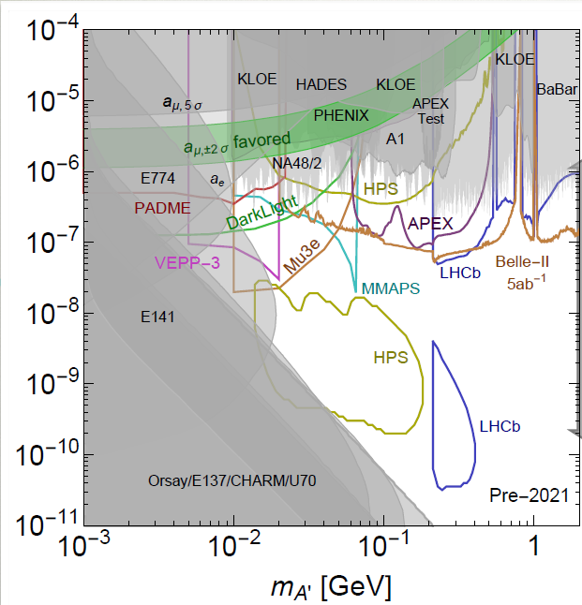
HPS Bump Hunt at 2.2 and 4.4 GeV Will Contribute Too

Slide 25
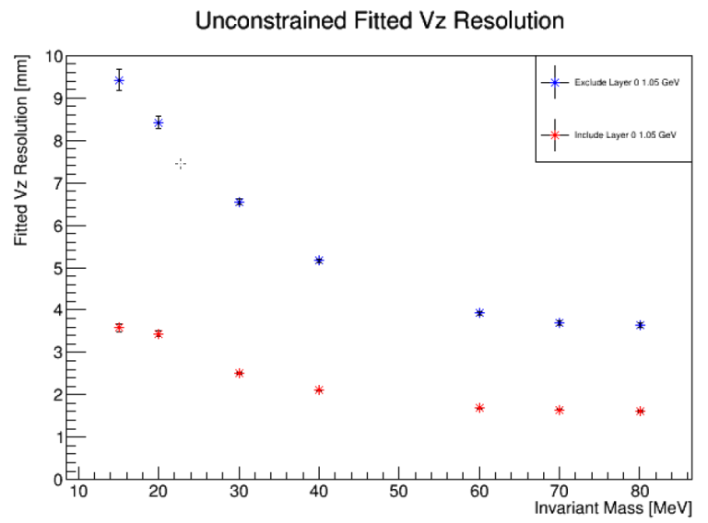
SVT Upgrade Boosts Reach
Vertex Resolution vs Mass
Adding a new Layer 0 * Reduces zcut by factor ~2 Boosts vertex efficiency Sensitive to shorter decays, larger ε * Improves mass resolution by ~20% (Matt S.)
Moving Layers 2/3 closer to beam * Boosts vertex efficiency by 50% * Vertex efficiency → 75% proposal
Matt S
Layer 1
Layer 0
Takashi

Slide 26
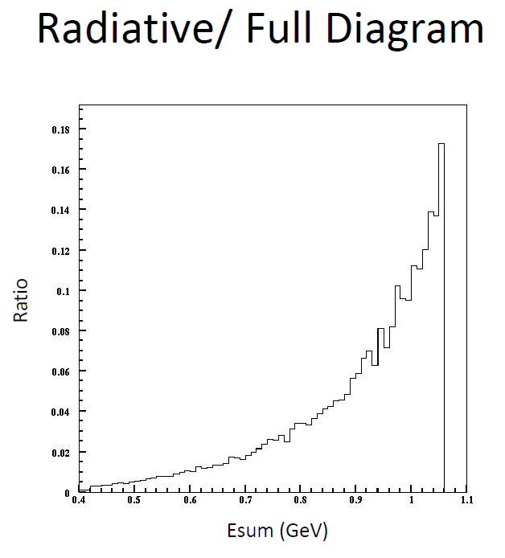
How to Boost Significance?
HPS coverage will depend on multi-week data runs and wringing more significance from the data.
How to boost Significance * Increase N_{bin} * Boost f_{rad} = N_{rad}/N_{total} * Improve δ_{m} Ecal assisted energy? Better alignment? Use Recoils? Layer 0? * Likelihood fitting? * Bright ideas! Please! *
F_{rad} grows with Esum Weight events?

Slide 27
Back of the envelope Projection
x
x
x
Proposal
x
x
x
x
x
x
x
x
x x x x x x x x
x
x
4 wks: 1.05 GeV Sho X 3

Slide 28
Preparing for the Next Run
Next run is scheduled for two months during Summer 2018. * Our first real, contiguous running! * Our first significant vertex search in virgin territory
Preparations * Upgrade installed before run * Need more students! * Need to train new Trigger, Beamline, SVT, and Ecal Experts * Need to handle lots of data: DQM, data processing, recon, and MC
New HPS Positions * MC Czar Refine simulation details, check generators, guarantee output * Tracking Czar Boost tracking efficiency, improve alignment, oversee performance studies
Enlist New Collaborators * Possibilities: Bertrand Echenard (Cal Tech); Robert Johnson (UCSC)

Slide 29
Publish or Perish
HPS needs to present it’s first results SOON to remain
credible with JLAB management and DOE HEP
Present 2015 Bump Hunt Results Ready for APS “April” Meeting Washington D.C., Jan. 28-31, 2017
Submit 2015 Bump Hunt Results for Publication ASAP! Ready by Spring 2017?

Slide 30
Conclusions
The “Engineering Runs” were aptly named. HPS works, can do physics, and can learn what it needs to from this data.
Omar and Sho have completed the first HPS analyses. Omar, Holly, et al. will push them to conference readiness and publication.
Analysis Group has made tremendous progress Understanding unexpected backgrounds, critical detector efficiencies, and physics generators.
Multi-week data taking runs will recover HPS’s vertex reach.
The HPS SVT Upgrade will boost our reach significantly. New ideas, which can boost our sensitivity further, could pay big dividends.
HPS is ready to do compelling physics! It needs new students, new subsystem experts, and thoughtful preparation to make the 2018 running an unqualified success.

